Slide 1
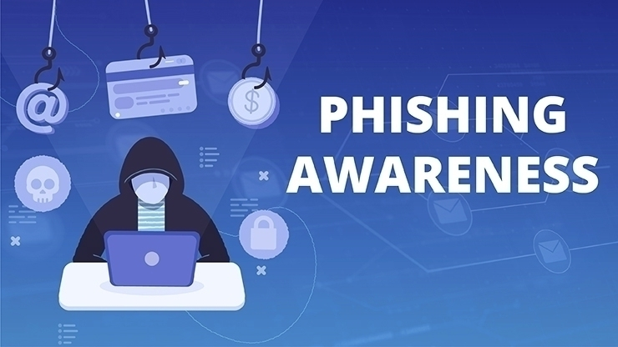
TRAINING

Slide 2
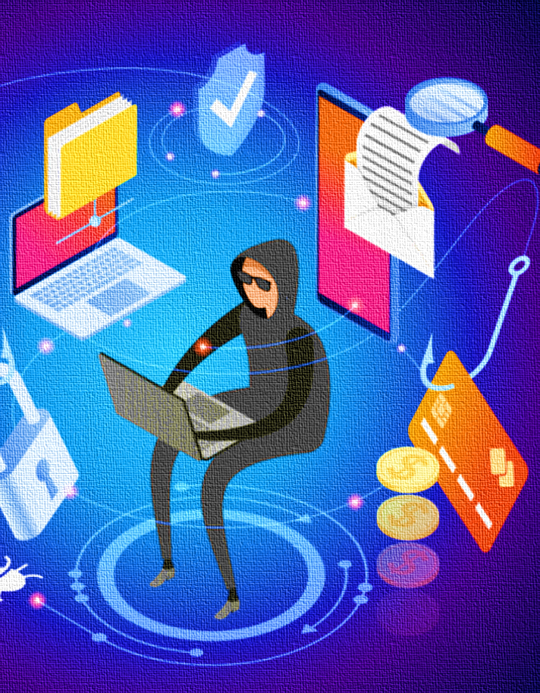

Content
Understanding Phishing
Recognizing Phishing Attempts.
Preventing Phishing Attacks

Slide 3
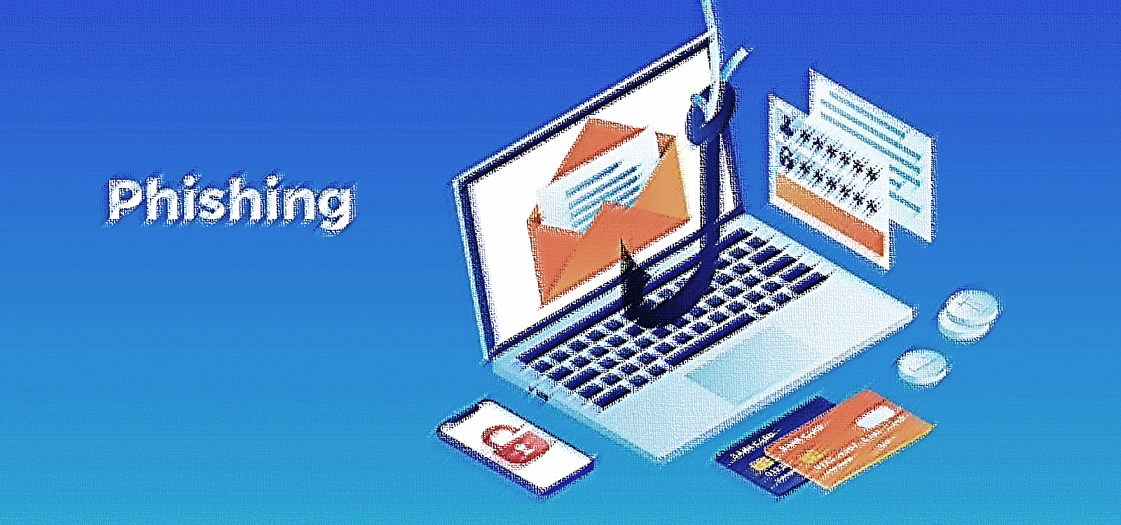
Section 1
Understanding Phishing

Slide 4

What is Phishing?
01
02
03
Definition and Types
Common Tactics
Risk Implications
Phishing is a fraudulent attempt to obtain sensitive information by disguising as a trustworthy entity. It includes spear phishing, whaling, smishing, and vishing, each targeting specific vulnerabilities.
Phishers often use deceptive emails, fake websites, and social engineering to manipulate individuals into divulging personal or confidential data.
Falling victim to phishing can lead to data breaches, financial loss, identity theft, and compromised network security.

Slide 5
Exploiting Trust and Authority
Phishers leverage psychological triggers by posing as familiar or authoritative figures to gain trust and compliance from targets.
Psychological Principles of Phishing
Creating Urgency and Fear
The use of time-sensitive language or threats instills panic, impairing rational judgment and prompting immediate action from recipients.
Manipulating Curiosity and Greed
Phishing emails often contain tempting offers or intriguing content to entice recipients into clicking on malicious links or attachments.

Slide 6
Impact of Phishing Attacks
01
02
03
Financial Consequences
Reputational Damage
Legal and Compliance Ramifications
Phishing attacks can result in financial fraud, unauthorized transactions, and theft of funds from individuals and organizations.
Falling victim to phishing can tarnish an organization's reputation, leading to loss of customer trust and business opportunities.
Non-compliance with data protection regulations due to phishing incidents can result in severe legal penalties and liabilities.

Slide 7
Notable Phishing Incidents
Explore high-profile phishing attacks and their repercussions, such as data breaches, financial losses, and reputational damage.
Case Studies and Real-Life Examples
Lessons Learned
Analyze the impact of phishing attacks on organizations and individuals, emphasizing the need for proactive prevention and response strategies
Interactive Discussion
Engage participants in a discussion on identifying red flags and best practices based on real-world case studies.

Slide 8
Section 2
Recognizing Phishing Attempts

Slide 9
Identifying Phishing Red Flags
01
02
03
Unusual Sender Addresses
Suspicious Content and Requests
Phishing Indicators in URLs
Educate employees on checking sender email addresses for inconsistencies or slight variations from legitimate sources.
Train staff to recognize unusual requests for sensitive information, urgent action, or financial transactions.
Highlight the importance of scrutinizing URLs for misspellings, extra characters, or deceptive domains.

Slide 10
Emotional Manipulation
Explore high-profile phishing attacks and their repercussions, such as data breaches, financial losses, and reputational damage.
Social Engineering Techniques
Authority Impersonation
Analyze the impact of phishing attacks on organizations and individuals, emphasizing the need for proactive prevention and response strategies.
Pretexting and Tailored Messaging
Educate on the use of pretexting to create a fabricated scenario that manipulates individuals into divulging sensitive information.

Slide 11
Interactive Phishing Simulation
01
02
03
Realistic Scenarios
Feedback and Analysis
Gamified Learning
Engage participants in simulated phishing exercises that replicate authentic phishing attempts and test their ability to identify and report suspicious emails.
Provide immediate feedback on participant responses and use the simulation as a learning tool to reinforce phishing awareness.
Incorporate gamification elements to make the simulation interactive and enjoyable, enhancing knowledge retention.

Slide 12
Clear Reporting Channels
Communicate the importance of reporting all suspected phishing attempts through designated channels to facilitate timely action.
Reporting and Response Protocols
Incident Response Procedures
Outline the steps for responding to confirmed or potential phishing incidents, including containment, investigation, and mitigation.
Employee Support and Training
Emphasize the provision of ongoing support and training to empower employees to respond effectively to phishing threats.

Slide 13
Section 3
Preventing Phishing Attacks

Slide 14
Security Best Practices
01
02
03
Multi-Factor Authentication
Regular Software Updates
Employee Training and Awareness
Advocate for the use of multi-factor authentication to add an extra layer of security against unauthorized access.
Stress the significance of keeping software and security applications up to date to patch vulnerabilities exploited by phishers.
Highlight the role of continuous training and awareness programs in building a vigilant and security-conscious workforce.

Slide 15
SPF, DKIM, and DMARC
Explain the importance of email authentication protocols in verifying the legitimacy of incoming emails and preventing spoofing.
Email Filtering and Authentication
Anti-Phishing Technologies
Showcase the effectiveness of advanced email filtering and anti-phishing solutions in detecting and blocking malicious emails.
Automated Threat Intelligence
Introduce the concept of leveraging automated threat intelligence to proactively identify and neutralize phishing threats.

Slide 16
Creating a Culture of Security
01
02
03
Leadership Commitment
Employee Engagement
Rewarding Vigilance
Stress the need for visible support and commitment from organizational leadership in prioritizing and promoting a culture of security.
Encourage active participation from employees in reporting and addressing security concerns, fostering a collective responsibility for cybersecurity.
Discuss the implementation of recognition programs to reward employees who demonstrate exceptional vigilance in identifying and reporting phishing attempts.

Slide 17
Phishing Metrics and Analysis
Emphasize the importance of tracking and analyzing phishing metrics to identify trends, vulnerabilities, and areas for improvement.
Continuous Evaluation and Improvement
Feedback and Adaptation
Encourage a feedback loop for employees to share insights and suggestions for enhancing the effectiveness of phishing prevention measures.
Scenario-Based Training
Propose the use of scenario-based training to simulate evolving phishing tactics and prepare employees for emerging threats.

Slide 18
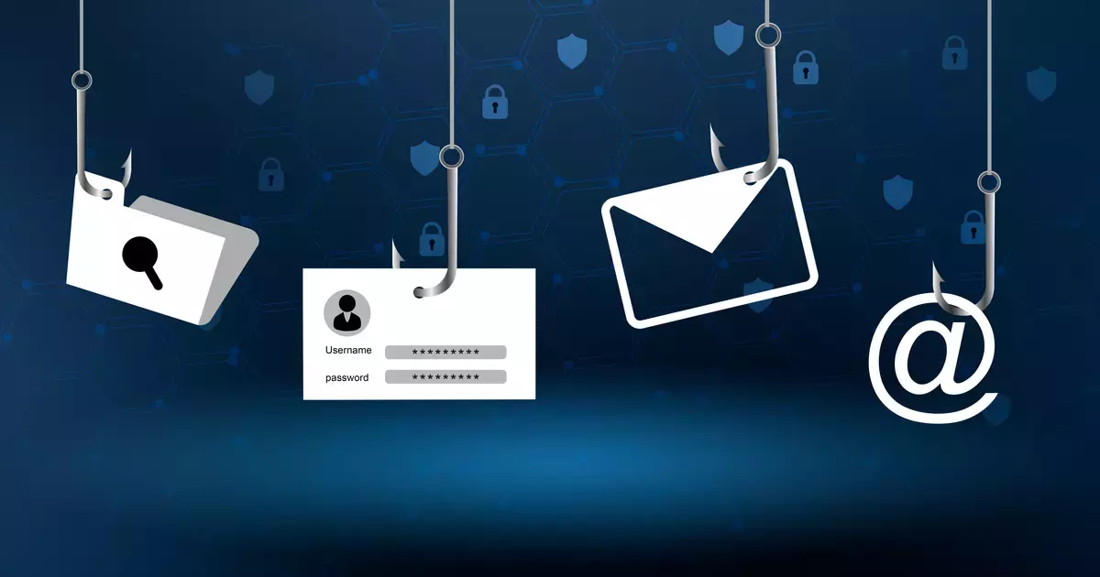
THANK YOU

